Slide 1


MUTATION RATE ANALYSIS AND GENE ENGINEERING
24AIM112 and 24AIM115
Team Members:
C M Prakateessh CB.AI.U4AIM24110
Mahashree C CB.AI.U4AIM24128
Reha Sreekumar CB.AI.U4AIM24146
Susanth Mohan Kamala CB.AI.U4AIM24148
Guide:
Mrs. Reshma sanal
Dr. Neelesh Ashok
1

Slide 2
INTRODUCTION
Mutation rates influence gene stability, evolution, and genetic diversity.
High mutation rates can lead to genetic disorders and reduced gene functionality.
Understanding mutation patterns helps predict gene stability.
Ethical considerations are integral to gene engineering, ensuring responsible use of technologies like CRISPR (Clustered Regularly Interspaced Short Palindromic Repeats) to balance innovation with potential societal and environmental impacts.
2

Slide 3
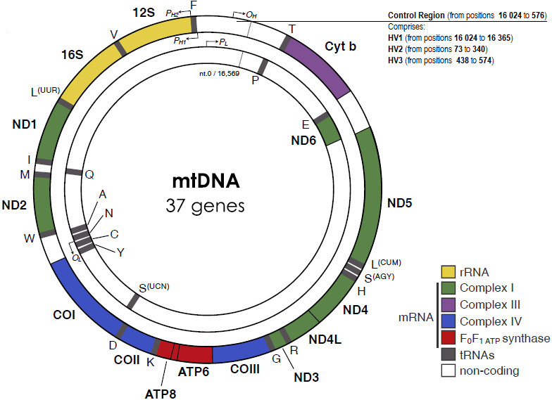
OBJECTIVE
To compare the mutation rates among 15 different species of mitochondrial gene.
To identify unstable genes and perform gene editing to enhance stability.
3

Slide 4

Expected Outcomes
Accurate Mutation Rate Analysis.
Accurate Evolutionary Rate Analysis.
Predicting the Stability of Gene Sequences
Effective Gene Engineering Strategies.
Cross-Species Comparative Insights.
Ethical and Regulatory Considerations.
4

Slide 5
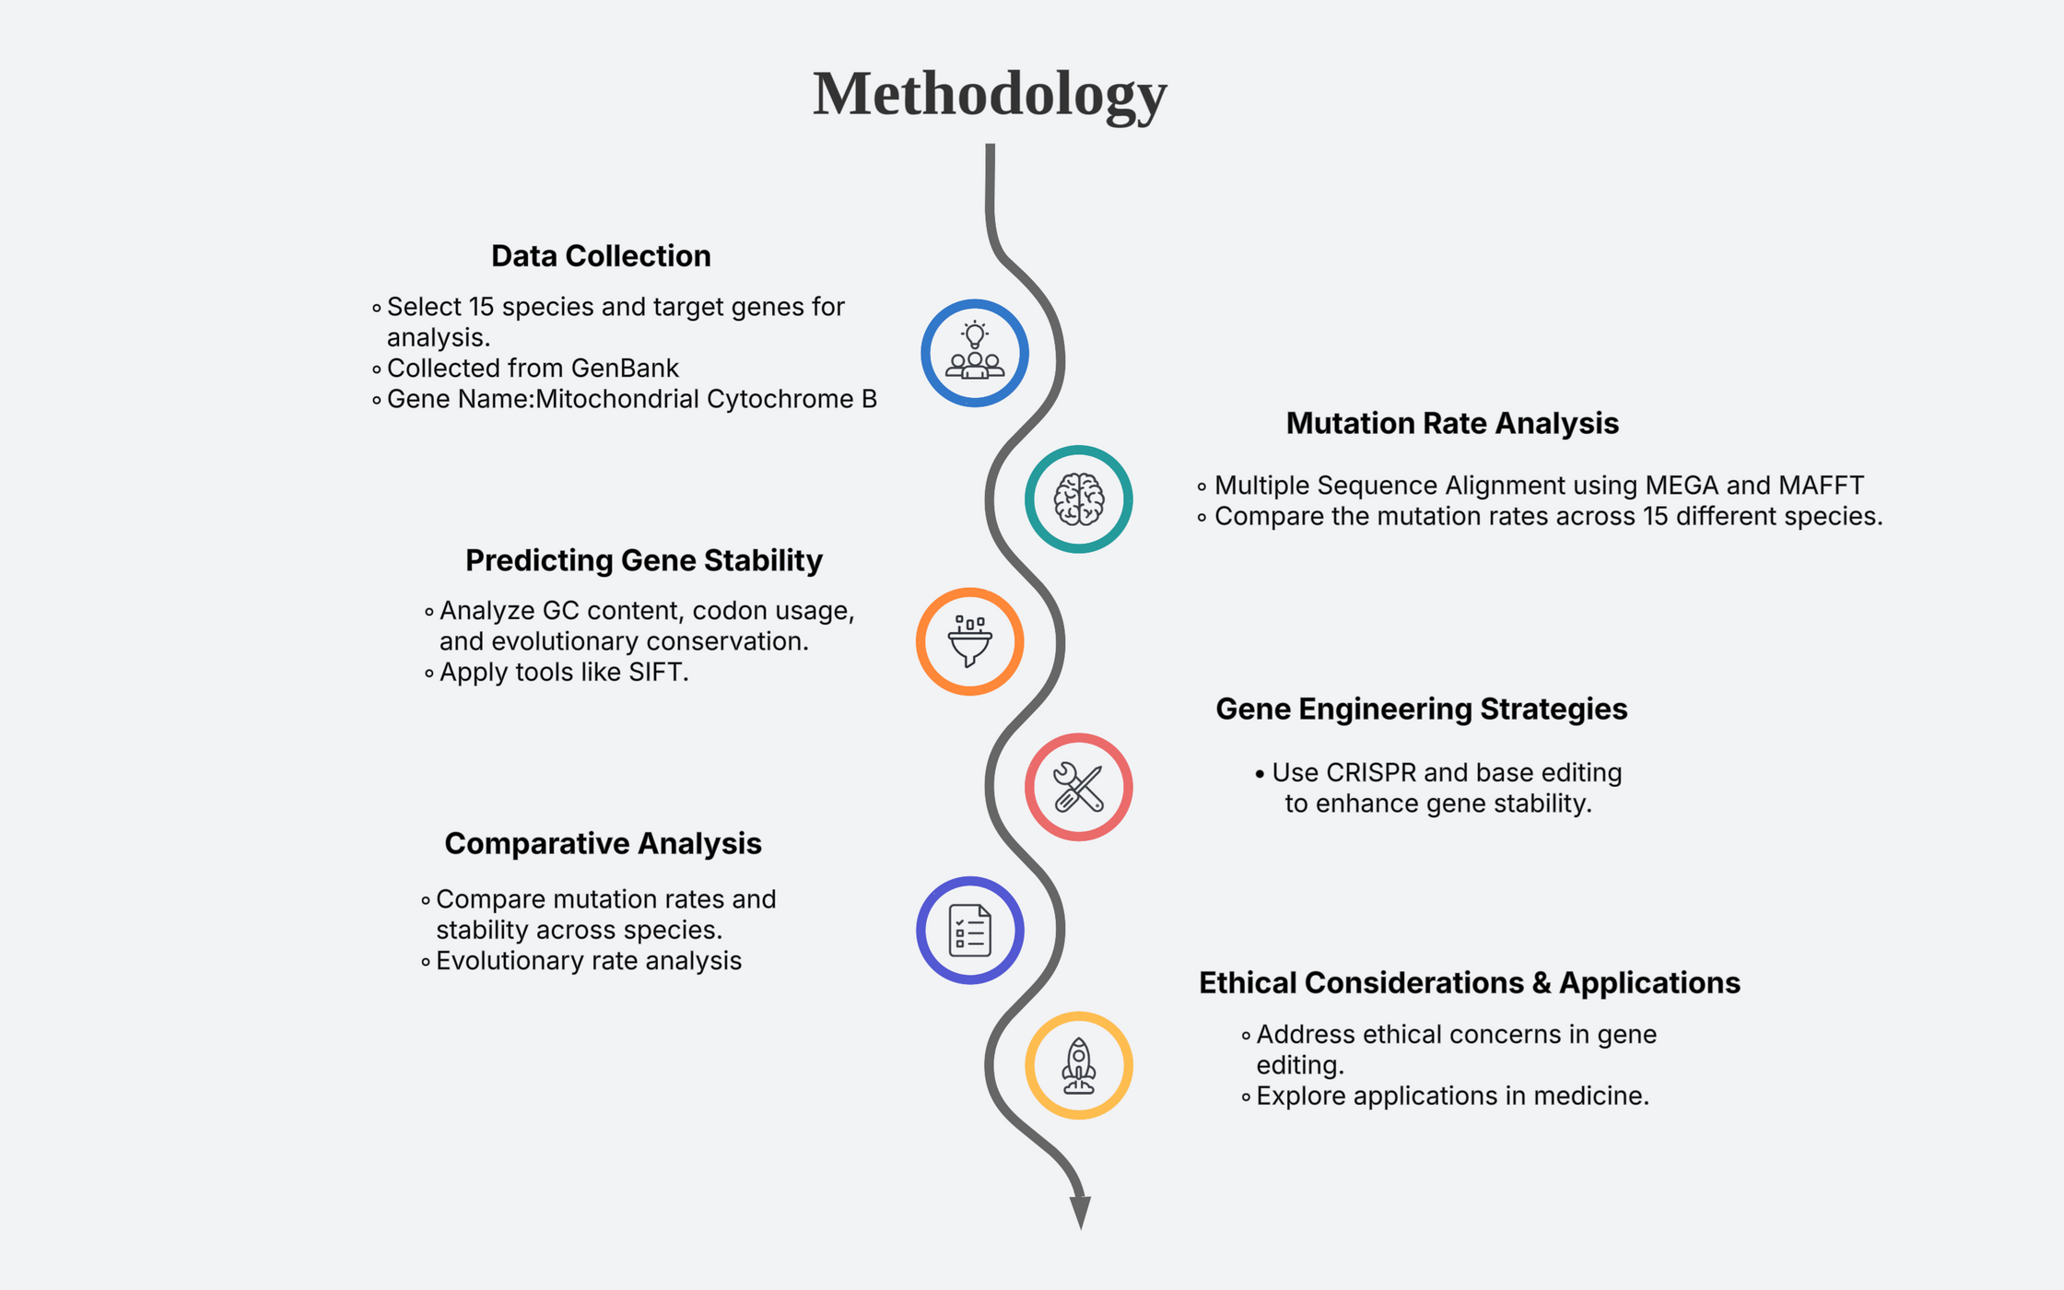
5

Slide 6
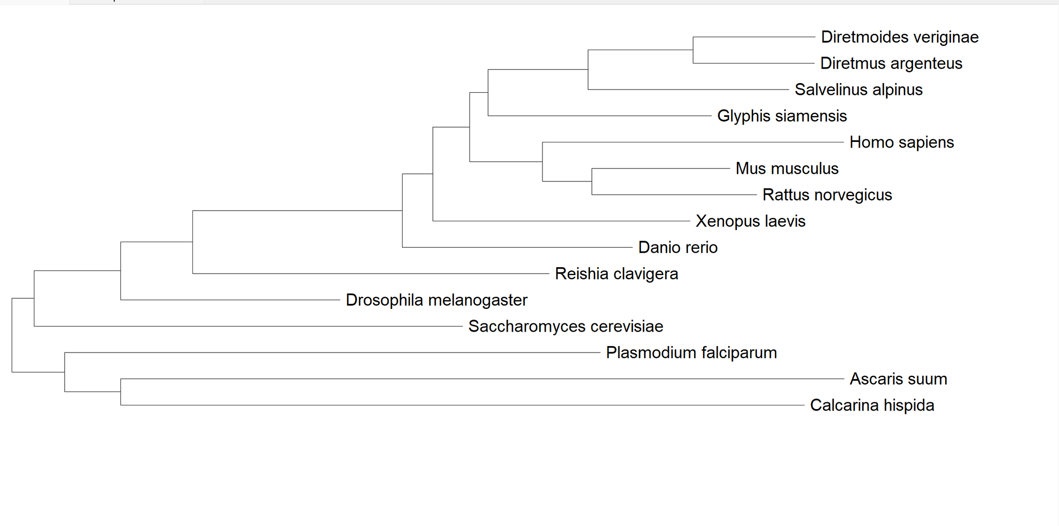
Phylogenetic Tree
6

Slide 7
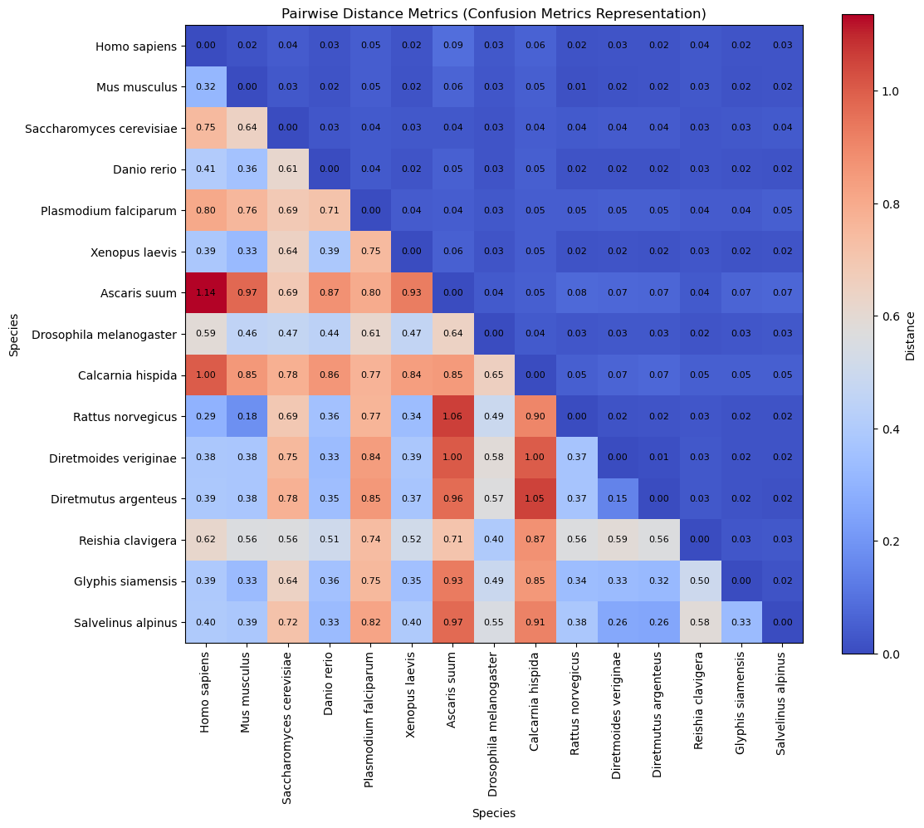

Confusion Matrix of Mutation Rate Analysis
7

Slide 8
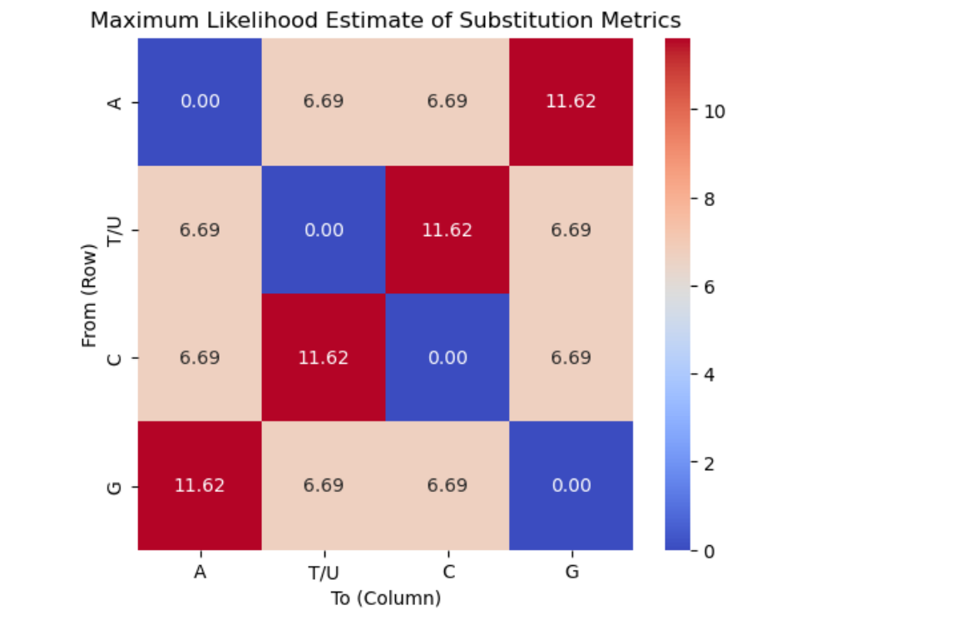
Confusion Matrix of Evolutionary Rate Analysis
8

Slide 9
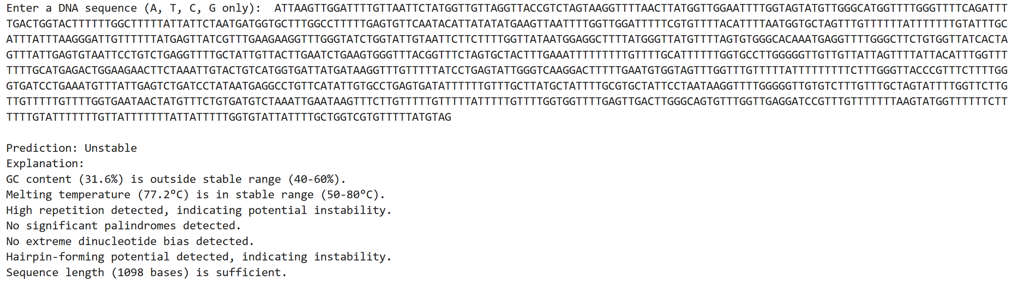
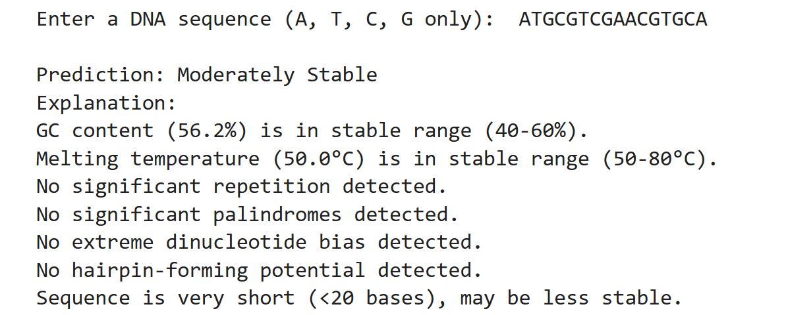
Predicting Gene Stability
9

Slide 10
Case Studies
CRISPR-Cas9 Gene Editing for Sickle Cell Disease and β-Thalassemia [2020]
He Jiankui’s CRISPR Babies Experiment [2018]
Embryo Screening for Intelligence [2024]
Genetically Modified Pets (Glowing Rabbits) [2025]
10

Slide 11
IPR
Methods and materials for making and using transgenic dicamba-degrading organisms.
Patent Number: US20150368683A1
2. CRISPR-Cas Systems and Methods for Altering Expression of Gene Products
Patent Number: US8697359B1
11

Slide 12

Conclusion
This project highlights the importance of mutation rate analysis in understanding gene stability across species. By leveraging computational models, we identified mutation rates and predicted gene resilience.
Gene engineering techniques, such as CRISPR, to stabilize genes and minimize harmful mutations, with potential applications in medicine.
Ethical considerations remain crucial, ensuring responsible use of genetic modifications while addressing concerns related to unintended consequences and biodiversity impact. This project offers insights into evolutionary biology and future genetic innovations.
12

Slide 13

THANK YOU!
13

